Slide 1
Financial and Management Accounting
Faculty Name
Faculty Department

Slide 2
INTRODUCTION TO ACCOUNTING
Lecture No. 1

Slide 3
What is Financial Accounting
Financial Accounting is the process of identifying, measuring and communicating financial information about an entity to permit informed judgements and decisions by users of the information.

Slide 4
What is Financial Accounting
Financial Accounting is the process of identifying, measuring and communicating financial information about an entity to permit informed judgements and decisions by users of the information.
What is the process?
How is financial information identified?
How is financial information measured?
How is financial information communicated?
What is an entity?
Who are the users of financial information about an entity?
What types of judgements and decisions do these users make?

Slide 5
Who are the users of financial information about an entity?
Financial accounting
Management –
Owners/Investors/promoters-
Tax Authorities
Creditors/Lenders
Regulatory Agencies/Auditors
Employees-layoff
Customers
Economic Planners
Analysts
Competitors
External reporting
Notes:
Vedanta
In September 2019, Thomas Cook collapsed after efforts by lenders and creditors to rescue the 178-year holiday business failed. The collapse was blamed on heavy debt, competition from online travel firms and geopolitical uncertainty. Over 100,000 tourists were left stranded around the world and had to be brought back home by special arrangements.

Slide 6
Management Accounting information
Management Accounting:
Provides detailed cost information for planning, decision making and control.
Internal Reporting

Slide 7
Managerial Accounting
Financial Accounting +Management Accounting= Managerial Accounting

Slide 8
Public Listed Co
The information contained in financial reports should be reliable and intelligible.
Provide for meaningful comparisons between a firm’s past financial history and the financial information of other firms.
Easy to understand
Objective, with explanations where required
Not very expensive to provide that information
The conventions, assumptions, concepts and rules which define accepted accounting practice should be followed by all companies and in a similar manner.

Slide 9
Accounting Concepts
Business Entity concept
Going concern concept
Money measurement concept
Cost concept
Dual aspect concept
Accounting Period Concept
Conservatism Concept
Realization Concept/ Accrual Concept
Matching Concept
Consistency Concept
Full Disclosure Concept
Materiality Concept

Slide 10
Business Entity concept
A business is treated as a separate entity that is distinct from its owner(s) and hence a distinction should be made between
(i) personal transactions and business transactions, and
(ii) transactions of one business entity and those of another business entity.
Notes:
The earliest accounting records, dating back more than 5,000 years, were found in Mesopotamia.These primitive methods used clay tokens and tablets to track agricultural goods, livestock, and transactionsVenice:Large complex international trade and business,so double entry system of accounting evolved.
double-entry bookkeeping used by Venetian merchants-complex international trade and business.
Crystallized by Luca Pacioli. In 1494, he published Summa de Arithmetica, Geometria, Proportioni et Proportionalita.
East India Company(Chartered company,created by a royal charter but no clear definitioj of separate legal entity) and Industrial Revolution: The rise of large corporations and complex manufacturing during the Industrial Revolution created a demand for more sophisticated accounting

Slide 11
Corporate veil-separate legal entity
ABCL
Kingfisher Airlines
Notes:
https://www.businesstoday.in/latest/corporate/story/united-breweries-united-spirits-grow-in-value-as-vijay-mallya-extradition-trial-enters-last-leg-249772-2020-02-10

Slide 12
Going concern concept:
The enterprise is normally viewed as a going concern, i.e. as continuing operations for the foreseeable future. It is assumed that the enterprise has neither the intention nor the necessity of liquidation.
RIL-Dhirubai Ambani
Infosys-Narayana Murthy

Slide 13
Money measurement concept
Only those transactions which are capable of being expressed in terms of money are included in the accounting records.
Human Capital-
RCB
Barcelona-Messi
Narayana Hrudayalaya -Dr. Devi Prasad Shetty
Employee loyalty,
Customer satisfaction,
Co reputation,
Working conditions,
Employee morale

Slide 14
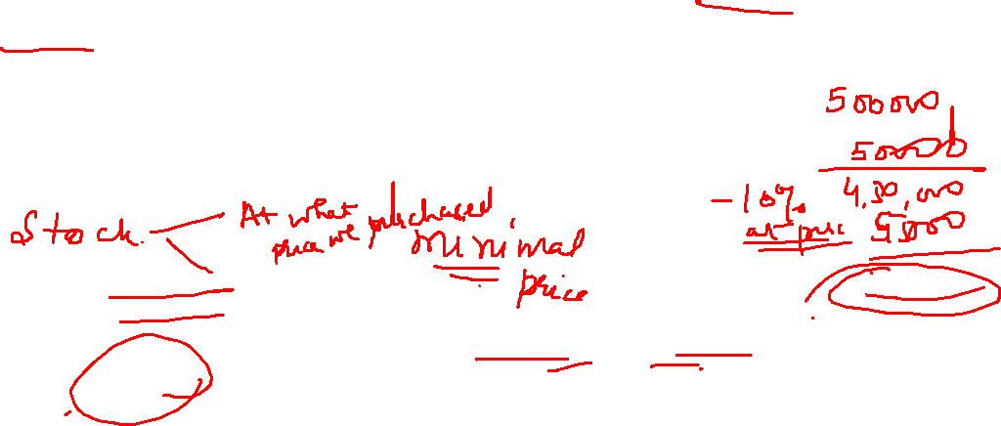
Cost concept
An asset is recorded in the accounting records at the price paid to acquire it at the time of its acquisition.(Cost)
The cost becomes the basis for the accounts during subsequent accounting periods. (objectively verifiable)
The cost of an asset is systematically reduced from year to year by charging depreciation and the asset is shown in the Balance Sheet at Book Value.
Closing stock is always valued at cost price or market price whichever is less(in p&l statement)
Notes:
AIccordingly, if nothing is paid to acquire an asset; the same will not be usually recorded as an asset,
IFRS allows land appreciation(write up)in some cases,gaap does not.GAAP-rule based,IFRS –Principle based
IFRS (International Financial Reporting Standards):
Used in 140+ countries, including:
All of the European Union
Australia
Canada
India (with some modifications, called Ind AS)
South Africa, Singapore, Brazil, and more
Purpose: To unify accounting standards internationally for better comparability and global investment.
🇺🇸 GAAP (Generally Accepted Accounting Principles):
Primarily used only in the United States.
Set by the Financial Accounting Standards Board (FASB).
More rules-based than IFRS, which is more principles-based.

Slide 15
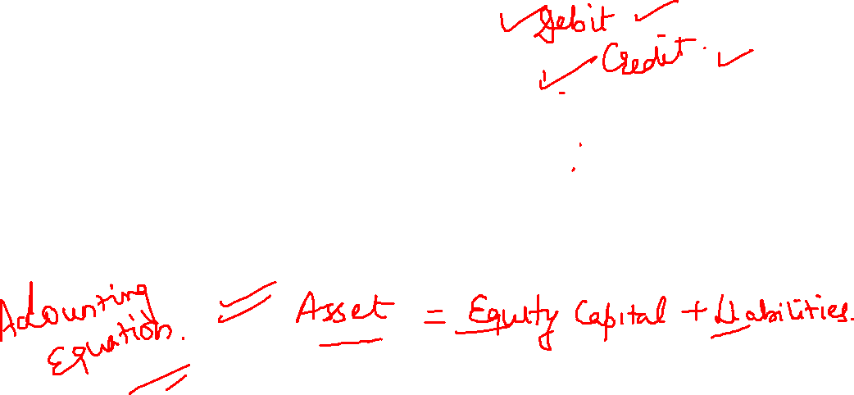
Dual aspect concept
Two fold aspect of a transaction is called dual aspect or duality of a transaction. This duality is the basis of double entry records.
As the name implies, the entry made for each transaction is composed of two parts— one for debit and another for credit.
Basis of Accounting

Slide 16
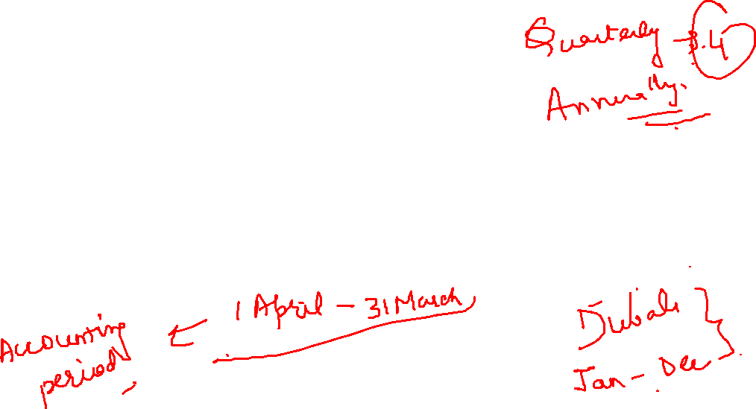
Accounting Period Concept
It is also known as Periodicity Principle or Time Period Principle. According to this principle, the economic life of an enterprise is artificially split into periodic intervals which are known as accounting periods(annual/quarterly), at the end of which an Income Statement and Balance Sheet are prepared to ascertain the Financial Performance and position respectively.

Slide 17
Conservatism Concept
Also called the Prudence Principle, this concept states that the business should ‘Anticipate no profit but provide for all probable losses’
It requires that in the situation of uncertainty and doubt, the business transactions should be recorded in such a manner that the Profits and Assets are not overstated and the Losses and Liabilities are not understated.

Slide 18
Conservatism Concept
Making the Provisions for Doubtful Debts and Discount on Debtor.
Closing stock is always valued at cost price or market price whichever is less. It is based on the principle of Conservatism.

Slide 19
Conservatism Concept
Mark to market used by Enron to value financial and non financial products like energy contracts
Assets can be recorded on a company’s balance sheet at their fair market value (as opposed to their book values)-financial products.
Instead of recording income as it was earned over time, they estimated the total future profit immediately (based on aggressive assumptions) and booked it all upfront.
$90 to 26 cents
Notes:
https://andersonadvisors.com/mark-to-market/#:~:text=Suffice%20it%20to%20say%2C%20though,appear%20in%20good%20financial%20health.
nron used MTM in non-financial business activities (like energy contracts), which was highly unusual and problematic.
Here's what they did:
Long-Term Contracts:
Enron signed 10–20 year energy contracts.
Instead of recording income as it was earned over time, they estimated the total future profit immediately (based on aggressive assumptions) and booked it all upfront.
Unrealistic Assumptions:
The future earnings were based on speculative projections, not actual performance.
Enron often overstated profits early on, while actual cash wouldn't come in for years (if ever).
Enron was a conglomerate that specialized in energy production and commodities, eventually transitioning into certain financial services (including brokerages). The Enron scandal and its subsequent downfall is the stock market drama of the last several decades. Enron’s fall from grace cost thousands of Americans their jobs and shook up Wall Street. Stock prices plunged from more than $90 to 26 cents before they filed for bankruptcy. There’s no mystery as to how such a massive corporation disintegrated almost overnight—it’s because it had an outstanding history of deceptive business practices. Additionally, Enron also used special purpose entities to hide a high amount of debt and soured assets from their creditors and investors.
As far as mark-to-market accounting went, Enron would engage in the building of assets (say, for instance, a power plant) and log its projected revenue on the books, even if it had yet to produce a dime of income or cash flow. If the asset ended up taking a loss, Enron would transfer the asset to a subsidiary that wasn’t on their own accounting record, essentially making it disappear
Under MTM accounting, assets can be recorded on a company’s balance sheet at their fair market value (as opposed to their book values). With MTM, companies can also list their profits as projections, rather than actual numbers.
An example of a company exploiting MTM accounting is if it were to report its projected cash flows that would result from a new piece of property, plant, and equipment (PP&E) such as a factory. Naturally, companies would be incentivized to be as optimistic as possible in their outlook since it would help bolster their stock price and encourage more investors to invest in the company.
When contracts underperformed, Enron used three major tricks:
Instead of marking assets down:They changed assumptions and Used more optimistic price curves
marking losses” in Special Purpose Entities (SPEs)
Using Enron stock to “hedge” losses (fake hedges)

Slide 20
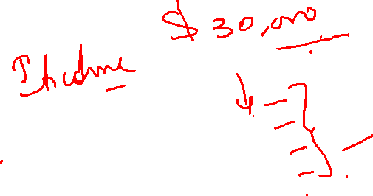
Accrual Concept
Revenues and Costs are accrued, that is, recognised as they are earned or incurred (and not as money is received or paid) and recorded in the financial statements of the periods to which they relate.
For companies it is mandatory to keep accounts on accrual basis under the Companies Act, 2013.

Slide 21
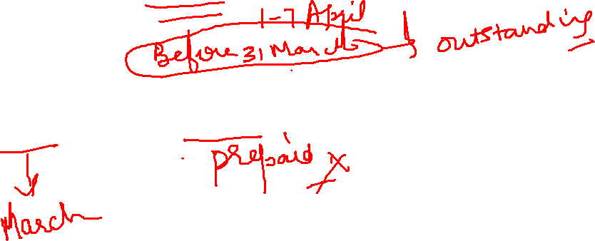
Accrual Concept
An employee has worked for the month of March 2025.Her salary of Rs 30,000 falls due on 31st March 2025.
On 31st march 2025,you pay the employee Rs 45,000.(30000(march)+15000 (salary advance for april)

Slide 22
Realization Concept/Revenue recognition concept
We recognize the revenue from sale of goods or provision of services when such goods are delivered or the services are rendered to customers(transfer of property in goods), not when cash is received.
We recognize the revenue(Income ) not when cash is received.

Slide 23

Realization Concept-IFRS 15 / Ind AS 115 / ASC 606
According to IFRS rules for revenue recognition are as follows:
Identify the customer contract (Contract exists if parties have approved it (written / oral / implied)
Identify the obligations in the customer contract
When control of the promised good or service transfers to the customer(legal title/physical possession/risk and reward/acceptance)
Over time vs point-in-time recognition
Notes:
Indicators of transfer of control (non-exhaustive)
Used to judge when control transfers:
Present right to payment
Transfer of legal title
Transfer of physical possession
Transfer of significant risks and rewards (only an indicator, not a test)
Customer acceptance

Slide 24
Realization Concept-IFRS 15 / Ind AS 115 / ASC 606
Over time vs point-in-time recognition
Revenue recognised over time if ANY ONE is met:
Customer simultaneously receives and consumes benefits(house cleaning/internet)
Customer controls the asset as it is created or enhanced(house construction)
Asset has no alternative use AND entity has enforceable right to payment (customized products)
Otherwise - point in time.(sale of goods)
Notes:
Indicators of transfer of control (non-exhaustive)
Used to judge when control transfers:
Present right to payment
Transfer of legal title
Transfer of physical possession
ASC stands for Accounting Standards Codification.
It is not a single standard, but the authoritative source of US GAAP.
Transfer of significant risks and rewards (only an indicator, not a test)
Customer acceptance

Slide 25
Realization Concept
1. Export Sales :
In some cases, revenue is deferred and can be recognized after shipment/after customs clearance/after buyer acceptance
Point in time
2. Advance Receipts for Services (Unearned Revenue):
When money is received before service is rendered (e.g., subscription), revenue is not recognized immediately.
Customer simultaneously receives and consumes benefits(house cleaning/internet)
3. Consignment Sales:
Revenue is recognized only when the consignee sells the goods, not when goods are sent to them.
Point in time.
Notes:
In hire purchase, the buyer uses the asset during the payment period, but ownership is transferred only upon full payment. In installment sales, ownership is immediately transferred to the buyer, even though they make payments over timehttps://www.toppr.com/guides/business-laws/the-sale-of-goods-act-1930/passing-of-property-part-1/
Installment sales may be regarded as calling for special treatment whereby gross profit is related to the
periods in which the installment receivables are collected rather than to the periods in which the
receivable are created. The inflow of cash (collections) rather than the time of sale become the criterion
for revenue recognition
1. Hire Purchase :
Revenue is recognized at the time of sale, even though payment is received in installments over time.
Why? Because the ownership and risks are transferred upfront.

Slide 26
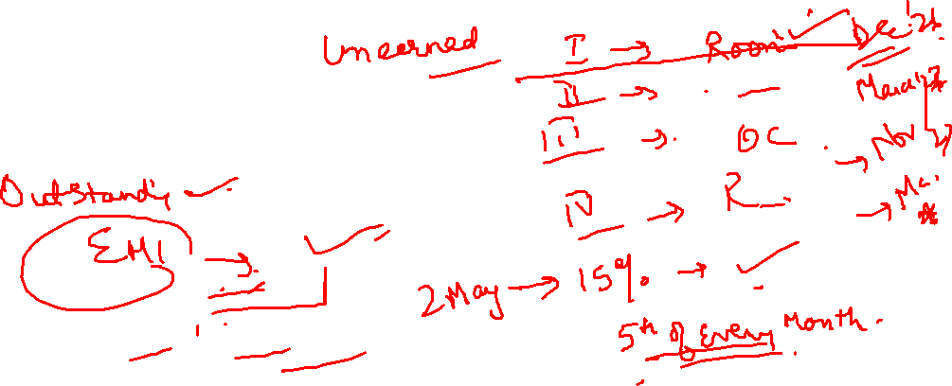
Exceptions:
Realization Concept
4. Long-Term Construction Contracts (Percentage of Completion Method):
Revenue is recognized gradually over time as construction progresses.
Customer controls the asset as it is created or enhanced and Asset has no alternative use AND entity has enforceable right to payment (customized products)
5. Installment Method:
Revenue is recognized as cash is collected, not when the sale occurs.
Significant risk of non payment; ownership transfer may be deferred.
6. Agricultural and Mineral Products:
Revenue is recognized at the point of harvest or extraction, not at sale.
Why? Market value is often reliably measurable at that point.
Exception-biological or natural assets
Notes:
https://www.toppr.com/guides/business-laws/the-sale-of-goods-act-1930/passing-of-property-part-1/
Installment sales may be regarded as calling for special treatment whereby gross profit is related to the
periods in which the installment receivables are collected rather than to the periods in which the
receivable are created. The inflow of cash (collections) rather than the time of sale become the criterion
for revenue recognition
“Economically, part of the performance obligation has been fulfilled, so part of the revenue and profit can be booked in the books of accounts
60% revenue recognized ≠ 60% ownership transferred
60% revenue recognized ≠ buyer can occupy 60% of the flat
Legal title remains with the developer until:
construction is completed
Occupancy Certificate (OC) is obtained
possession is formally handed over
sale deed is executed / registered

Slide 27
Aggressive/Improper Revenue recognition
1)Frontloading revenue
Xerox (USA): Recognised revenue upfront on long-term copier lease contracts
Xerox sold high-end photocopiers to corporate customers using long-term lease / rental contracts (typically 3–5 years).
These contracts bundled three different elements:
The copier machine itself
Servicing & maintenance over the lease term
Consumables / support (toner, parts, etc.)
2)Inflated assumptions :
Recorded revenue on energy trades with inflated future assumptions
Notes:
Channel stuffing is an accounting and sales practice where a company inflates its revenue by sending more products to distributors or retailers than they can actually sell, often near the end of a reporting period.
OEMs, like laptop or server manufacturers, buy components in bulk.(Original equipment manufacturers)
Toshiba pushed extra units to hit quarterly targets.
OEMs often had to accept the excess due to contractual pressure or sales incentives, even if they didn’t need them right away.
Xerox sold high-end photocopiers to corporate customers using long-term lease / rental contracts (typically 3–5 years).
These contracts bundled three different elements:
The copier machine itself
Servicing & maintenance over the lease term
Consumables / support (toner, parts, etc.)
Customers paid Xerox periodic lease rentals over several years.
2) What Xerox should have done (correct accounting)
Under proper revenue recognition principles:
Revenue from the machine → should be recognized when the machine is delivered (or over time, depending on control transfer)
Revenue from service & maintenance → should be recognized over the lease period as services are performed
So revenue should have been spread over several years, matching:
when cash was received
when services were actually provided
This is consistent with:
Matching principle
Substance over form

Slide 28
Aggressive/Improper Revenue recognition
3)Bill-and-hold transactions (goods not delivered)
Dell : Recognised revenue while retaining goods
Goods not yet assembled or ready to ship
Goods still in warehouse(though customer didn’t ask for delayed delivery)
So revenue was recognized before control was transferred.
4)Channel Stuffing
HP : pushed excess printers and PCs to resellers and distributors to meet quarterly sales targets near quarter endings and recognized revenue on shipment.
Distributor just stocking up with extended payment terms and liberal return rights
Toshiba: Excess products to retailers and components to OEMs
Notes:
Channel stuffing is an accounting and sales practice where a company inflates its revenue by sending more products to distributors or retailers than they can actually sell, often near the end of a reporting period.
OEMs, like laptop or server manufacturers, buy components in bulk.(Original equipment manufacturers)
Toshiba pushed extra units to hit quarterly targets. Dell normally needs 50,000 hard drives per quarter
Near quarter-end, Toshiba is short on revenue
So Toshiba:
Ships 120,000 hard drives to Dell
Dell only needs 50,000
OEMs often had to accept the excess due to contractual pressure or sales incentives, even if they didn’t need them right away.
Xerox sold high-end photocopiers to corporate customers using long-term lease / rental contracts (typically 3–5 years).
These contracts bundled three different elements:
The copier machine itself
Servicing & maintenance over the lease term
Consumables / support (toner, parts, etc.)
Customers paid Xerox periodic lease rentals over several years.
2) What Xerox should have done (correct accounting)
Under proper revenue recognition principles:
Revenue from the machine → should be recognized when the machine is delivered (or over time, depending on control transfer)
Revenue from service & maintenance → should be recognized over the lease period as services are performed
So revenue should have been spread over several years, matching:
when cash was received
when services were actually provided
This is consistent with:
Matching principle
Substance over form

Slide 29
Aggressive/Improper Revenue recognition
Capitalising revenue-like items
WorldCom :Capitalised line costs instead of expensing them
IL&FS Group
Aggressive percentage-of-completion accounting on long term infrastructure projects
Yes Bank:
Interest income recognised on stressed assets(potential NPAs)
Under-provisioning
Notes:
Channel stuffing is an accounting and sales practice where a company inflates its revenue by sending more products to distributors or retailers than they can actually sell, often near the end of a reporting period.
OEMs, like laptop or server manufacturers, buy components in bulk.(Original equipment manufacturers)
Toshiba pushed extra units to hit quarterly targets.
OEMs often had to accept the excess due to contractual pressure or sales incentives, even if they didn’t need them right away.
stressed borrowers (companies unable to pay interest on time).

Slide 30

Matching Concept
The expenses incurred in an accounting period should be matched with the revenues recognised in that period. It means that, if revenue is recognised on all goods sold during a period, cost of those goods sold should also be charged to that period.
It is wrong to recognise revenue on all sales, but charge expenses only on such sales as are collected in cash till that period.
This concept is based on accrual concept since, it disregards the timing and the amount of actual cash inflow or cash outflow and concentrates on the occurrence (i.e. accrual) of revenue and expenses.

Slide 31

Full Disclosure Concept
The financial statements must disclose all the relevant and reliable information which they purport to represent, so that the information may be useful for the user and the can make a correct assessment about the financial performance and position of the enterprise.

Slide 32
Full Disclosure Concept
H&M
Satyam ,
Enron Fraud

Slide 33
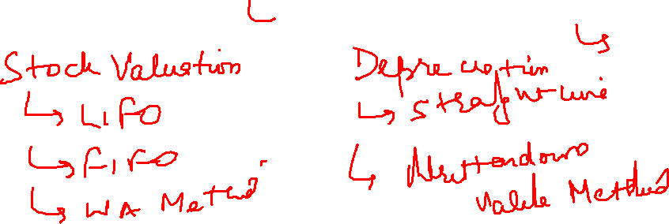
Consistency Concept
It is assumed that accounting policies are consistent from one period to another. Whatever accounting practices are selected for a given category of transactions, they should be followed on a horizontal basis from one accounting period to another to achieve comparability.

Slide 34
Consistency Concept
If the inventory is valued on LIFO basis, this basis should be followed year after year.
If a particular asset is depreciated according to WDV method, this method should be followed year after year.

Slide 35
Consistency Concept
If a particular asset is depreciated according to WDV method, this method should be followed year after year.

Slide 36

Materiality Concept
All relatively relevant items, the knowledge of which might influence the decision of the user of the financial statements, should be disclosed in the financial statements.
Which information is more relevant than other is largely a matter of judgement.
Materiality depends upon the amount of item ,the size of business, level and nature of information.

Slide 37
Materiality Concept
This Principle is basically an exception to the Full Disclosure Principle.
The full disclosure principle requires that all facts necessary to ensure that the financial statements are not misleading, must be disclosed, whereas the materiality principle requires that the items or events having an insignificant economic effect or not being relevant to the user's need not be disclosed.

Slide 38
Accounting Concepts-Example
X, owns a personal residence that cost `6,00,000, but has a market value of `9,00,000. During preparation of the financial statement for the his business(X ltd) , the entire value of property was ignored and was not shown in the financial statements. Which of the accounting concept was followed by him?
SOLUTION
Business Entity concept

Slide 39
Accounting Concepts-Example
State the name of the relevant accounting assumption or principle applied
Appending notes to the financial statements.
Full Disclosure Concept
Accounting of a small calculator as an expense and not as an asset.
Materiality Concept
Following the WDV method of depreciating a particular asset year after year.
Consistency Concept
Valuation of stock at lower of cost or net realisable value.
Cost Concept

Slide 40
Accounting Concepts-Example
State the name of the relevant accounting assumption or principle applied
Making provision for bad and doubtful debts.
Conservatism Concept
In gold mining, revenue is recognised in the accounting period in which the gold is mined.
Realization Concept
Classification of assets as current assets and fixed assets.
Going concern Concept
Transactions are recorded at their original cost.
Cost Concept

Slide 41
Thank You!

